Slide 1

IoT, mint inflexiós pont
Moore-törvény
Koomey-törvény
Metcalf-törvény
Transistors
Computations
per KWh
10,000,000,000
1.E+14
1,000,000,000
1.E+12
100,000,000
1.E+10
10,000,000
1.E+08
1,000,000
1.E+06
100,000
1.E+04
10,000
1.E+02
1,000
1.E+00
1970
1980
1990
2000
2010
1940
1975
2010

Slide 2

7200 MILLIÁRD DOLLÁR az IoT-piac várható mérete 2020-ban (a magyar GDP 50-szerese)
25 MILLIÁRD összekapcsolt “dolog”
IDC: Worldwide and Regional Internet of Things (IoT) 2014–2020 Forecast
Gartner

Slide 3
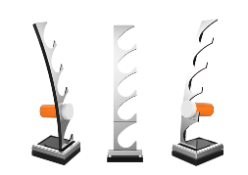
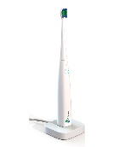

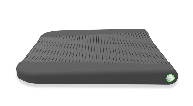




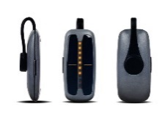

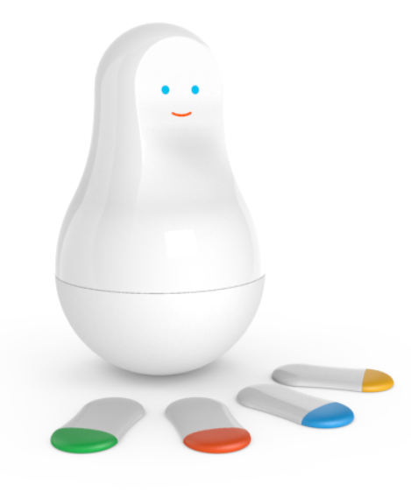
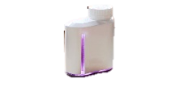

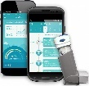
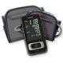

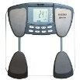
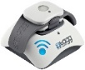
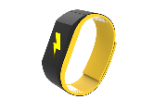







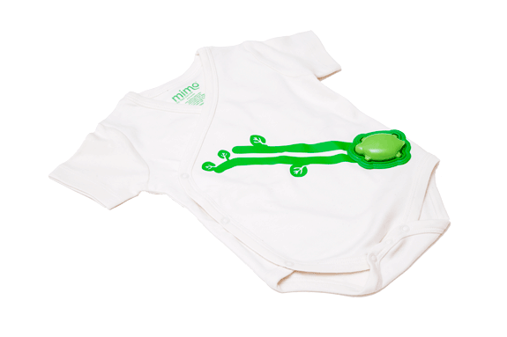
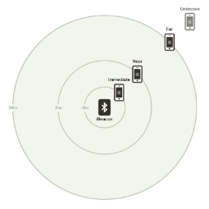
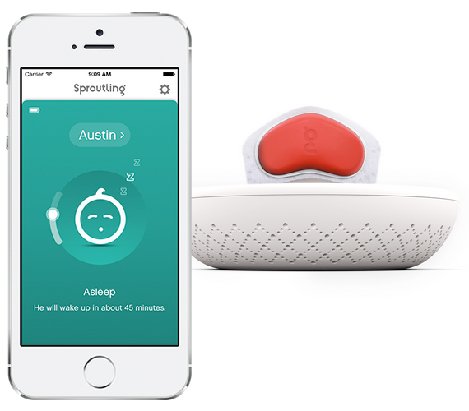


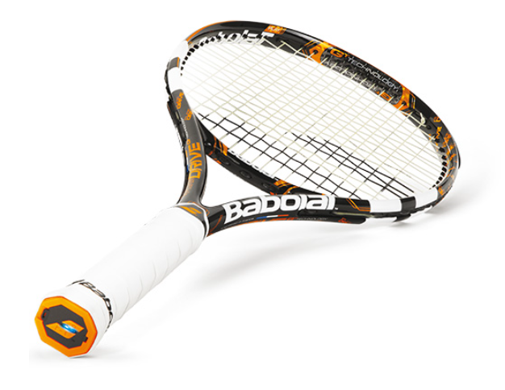

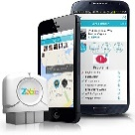


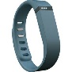
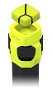
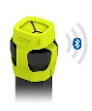




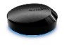
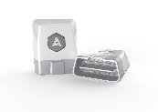
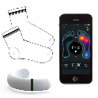

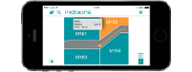



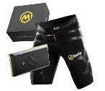



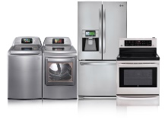

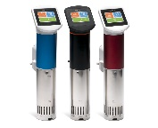
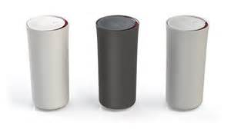

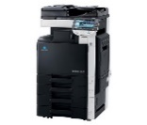
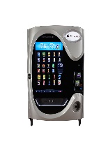
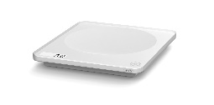
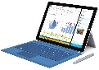
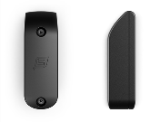
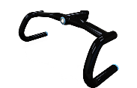
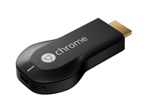



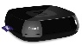
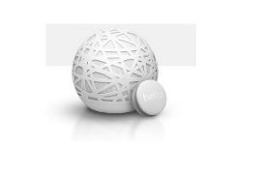
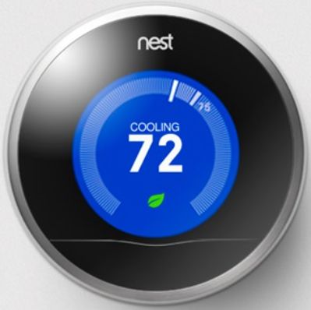
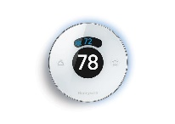
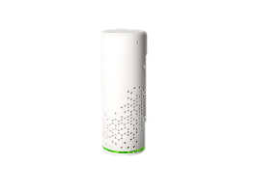

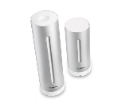


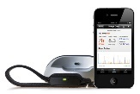
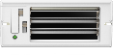



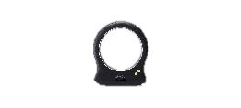

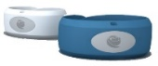
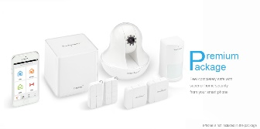
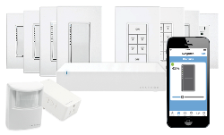

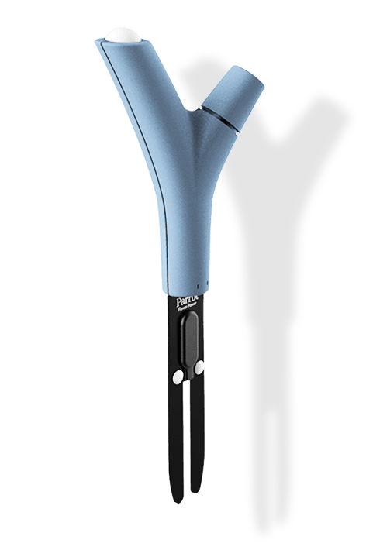

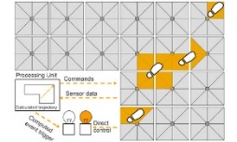
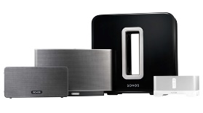




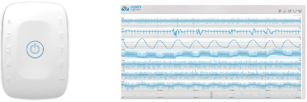




IoT 2016
Medication adherence
Health monitoring
Pet tracking
Behavior modification
Object tracking
Child and elder monitoring
Sports and fitness
Indoor navigation
Trip tracking and car health
Smart lighting
Beacons and proximity
COMMUTE
COMMUTE
HOME
WORKPLACE
HOME
Smart appliances
Food and nutrition tracking
Identity
Office equipment
Smart vending machines
Bike ride stats and protection
Air conditioning and temperature control
Sleep tracking
Environmental sensors
Information capture
Control
Home security
Home automation
Leak detection
Garden, lawn and plant care
New devices and sensors
Entertainment systems

Slide 4

Windows Embedded konvergencia
v7
v8
Windows Embedded Standard
v8.1
Windows Embedded
Windows Embedded Handheld
Windows 10
Porting Tools
Converged
OS kernel
Converged
app model
Windows on Devices
v6.5
Windows Embedded Compact
v7
v2013

Slide 5



Windows 10 IoT kiadások
Windows 10 IoT for industry devices
Desktop Shell, Win32 alkalmazások
Minimum: 1 GB RAM, 16 GB tár
X86/x64
Windows 10 IoT for mobile devices
Modern felület, Mobil appok
Minimum: 512 MB RAM, 4 GB tár
ARM
Windows Updates
Visual Studio & UWP
New User Interfaces
+
Windows 10 IoT Core
Nincs shell és előtelepített programok
Minimum: 256MB RAM, 2GB tár
X86/x64 or ARM
Security & Identity
Microsoft
Azure IoT
Integrated Device Connectivity

Slide 6





Egy IoT megoldás felépítése
Batch Analytics & Visualizations
Azure HDInsight, AzureML, Power BI,
Azure Data Factory
Cloud Gateway
Event Hubs
&
IoT Hub
Hot Path Analytics
Azure Stream Analytics, Azure HDInsight Storm
Presentation &
Business Connectivity
App Service, Websites
Dynamics, BizTalk Services, Notification Hubs
Protocol Adaptation
Hot Path Business Logic
Service Fabric & Actor Framework
Field Gateway
Protocol Adaptation
Eszközök
RTOS, Linux, Windows, Android, iOS
Field Gateway
Eszköz kapcsolódás és menedzsment
Analitika & Feldolgozás
Megjelenítés & Üzlet

Slide 7

Meeting Police
DEMO

Slide 8

Keressen bennünket: balint.farkas@microsoft.com dudas.viktor@microsoft.com
Értékeljen bennünket:
http://speakerscore.com/J8D3

